Slide 1



AI Based Human–Elephant Conflict Prevention System

Slide 2
Problem Statement:
Human–elephant conflicts are rising, leading to crop damage, property loss, and risk to human lives in regions near forests.
Lack of real-time monitoring prevents early detection of elephants entering villages, farms, and roadside areas.
Forest rangers receive delayed information, making it difficult to respond quickly and prevent conflicts.
Travelers on forest roads remain unaware of elephant movement, increasing the chances of accidents.
Farmers have no automated early warning system, resulting in sudden elephant encounters and extensive agricultural loss.

Slide 3

Goal & Learning Objectives
Goal of the Project
To create an AI system that detects elephants early and alerts people
to prevent accidents and protect crops.
Learning Objectives
Learn to use AI for real-time elephant detection.
Understand how to send automated alerts using Pushbullet.
Gain skills in activating alarms and safety systems.
Apply technology to reduce human–elephant conflict sustainably.
GOAL
Source :
www.freepik.com/

Slide 4
Solution:
Use an AI-based YOLO model to detect elephants in real time from continuous camera feeds.
Send instant alerts to forest rangers via Pushbullet when an elephant is detected.
Trigger warning sounds automatically in nearby farm areas to prevent crop damage safely.
Display alerts on digital boards near roads to warn travelers and avoid accidents.
Save detection screenshots with timestamps to help track movement patterns and support future planning.

Slide 5
Tools and Technology used
YOLO – AI model for real-time elephant detection
Python – Main programming language
OpenCV – For camera access, image processing, and frame display
Pushbullet API – To send instant alert notifications
Winsound / MP3 Player – For continuous alarm sound
Laptop/PC Camera or CCTV Feed – For real-time monitoring
Datetime & OS modules – For timestamping and saving screenshots

Slide 6
Methodology
Set up a live camera feed for continuous monitoring.
Use YOLO to detect elephants in each video frame in real time.
Identify elephant presence and trigger alert logic.
Capture and save screenshots with timestamps when detection occurs.
Send instant Pushbullet alerts to forest rangers and authorities.
Activate continuous sound alarms to protect nearby crops.
Display annotated video output for monitoring and verification.
Reset alerts and alarms when the elephant leaves the area.

Slide 7
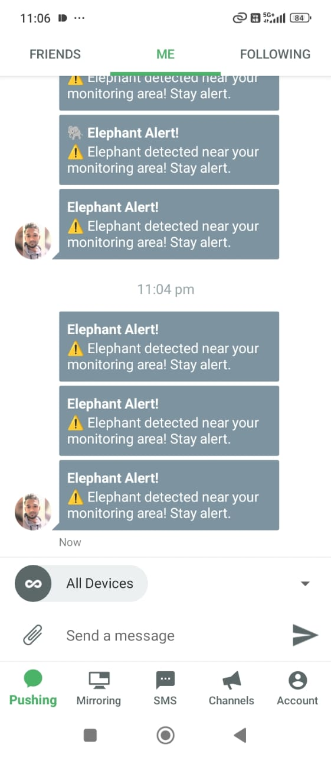
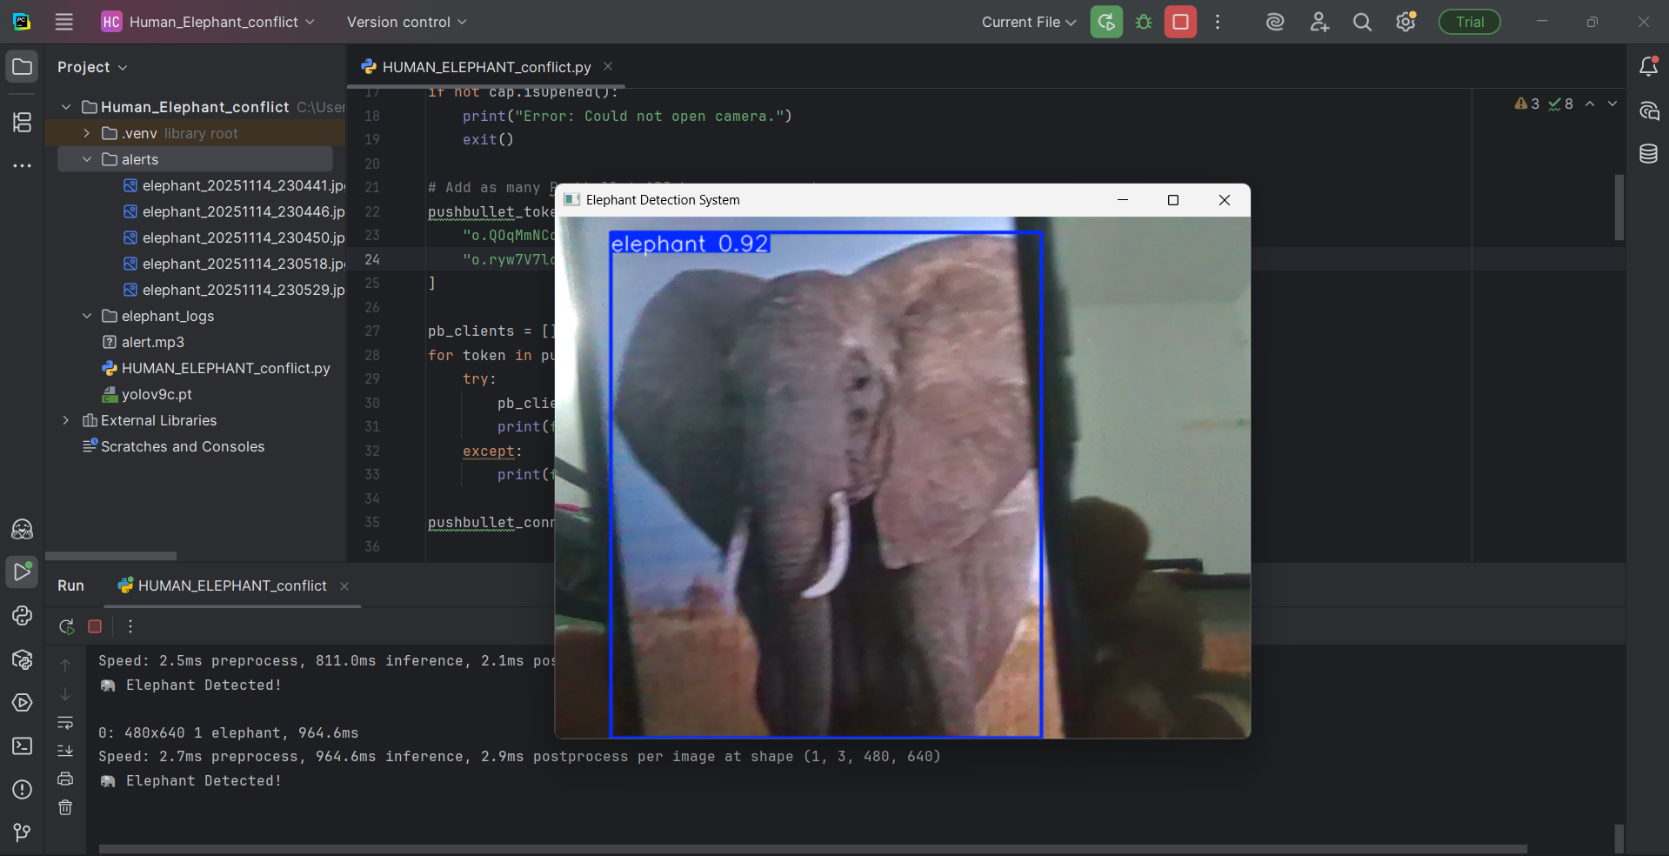
Screenshot of Output:

Slide 8
Conclusion:
The system effectively reduces human–elephant conflict by providing early, accurate detection of elephant movement.
Real-time alerts help forest rangers respond faster, improving safety for both people and wildlife.
Warning sounds and digital boards protect farmers and travelers, minimizing crop loss and road accidents.
The AI-based solution is sustainable and non-invasive, ensuring elephants are not harmed while promoting coexistence.
Overall, the project creates a safer environment by combining technology, automation, and conservation-focused strategies.

